Slide 1

Creating J.A.R.V.I.S.

Slide 2
Creating J.A.R.V.I.S.
An Awesome Guide To Automating Your Home
By Scott Preston

Slide 3
About Me
Live in Columbus, Ohio.
Been doing robotics for last 15 years
Wrote a few books on robotics and mobile/js/html5.
Practice Lead at ICC focusing on JavaScript
I’ll be at ICC booth after this talk pairing with JR.
First brought my robot to CodeMash in 2009.

Slide 4
What’s J.A.R.V.I.S. stand for?

Slide 5
J.A.R.V.I.S.
J – Just
A – A
R – Rather
V – Very
I – Intelligent
S - System

Slide 6
About J.A.R.V.I.S.
Ubuntu Server 14.04
Core i5 / 16GB Ram / 240GB SSD
1GB Ethernet / 1 Bluetooth
4 USB Serial Ports
4 Slave Raspberry PIs w/LIRC & Temp Sensors
9 Network Cameras
1 Windows Machine for Skype
@jarvispreston (Twitter Handle)

Slide 7
How did I get here?

Slide 8

Summer 2008

Slide 9
Initial Goals
Turn lights on/off Sunrise / Sunset
Wake me up with weather report

Slide 10
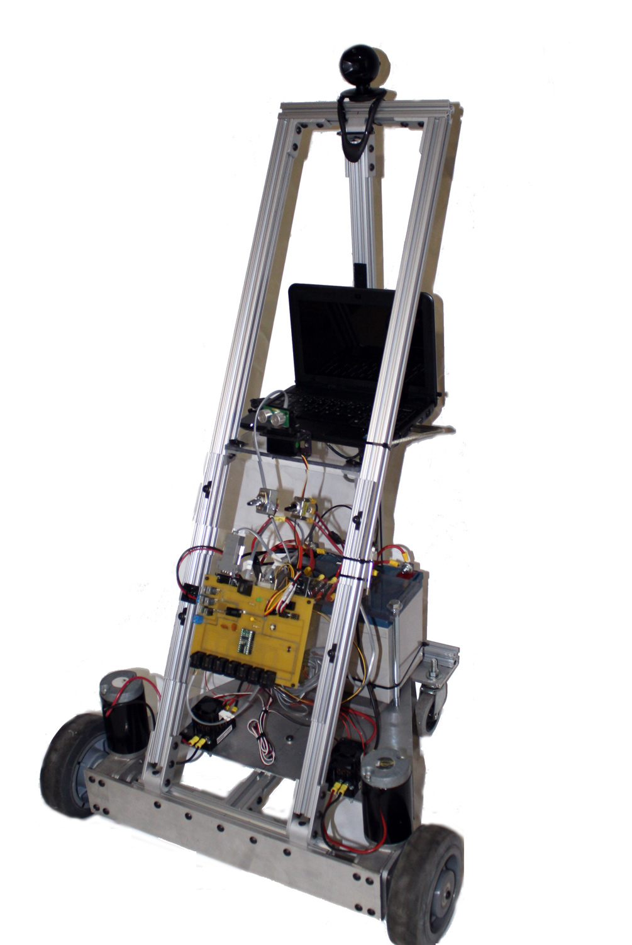
I had an old robot (JR-MK2)

Slide 11
Robot Had 2 Parts I needed
Basic Stamp & Distribution Board
Serial Servo Controller

Slide 12
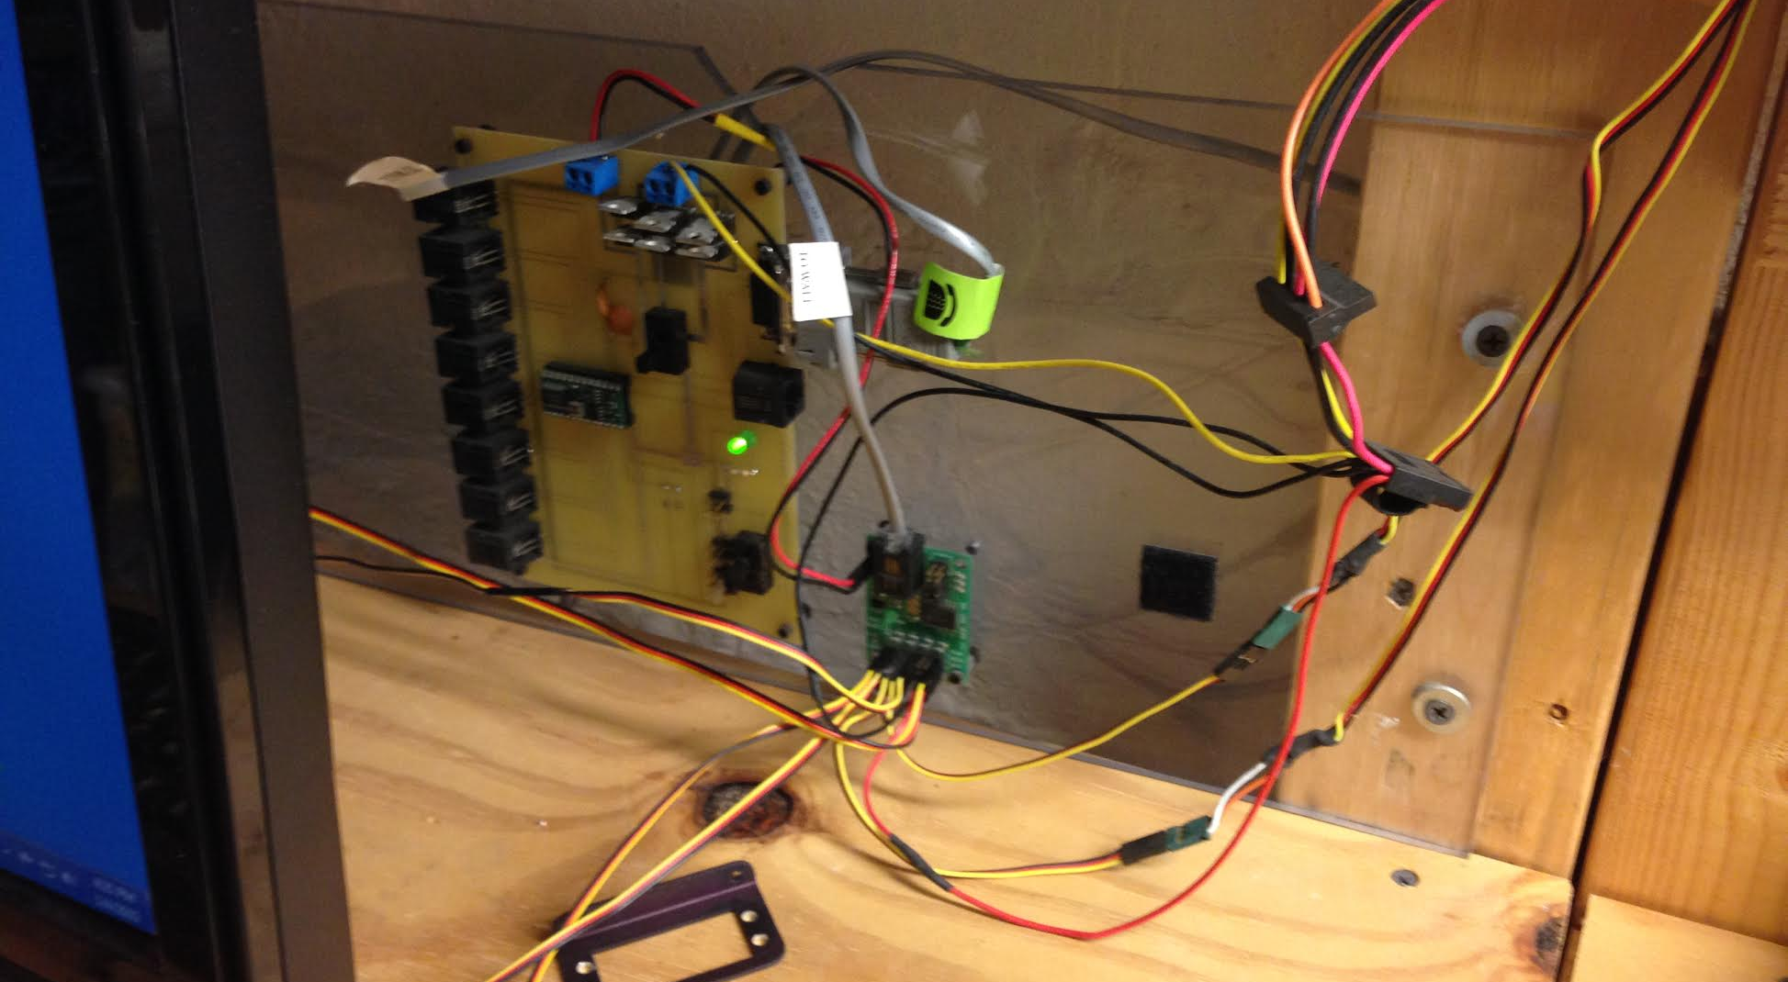
Stamp & Controller Board

Slide 13
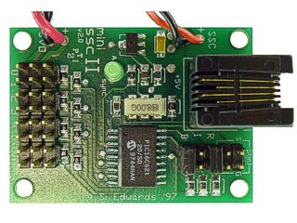
SSC

Slide 14
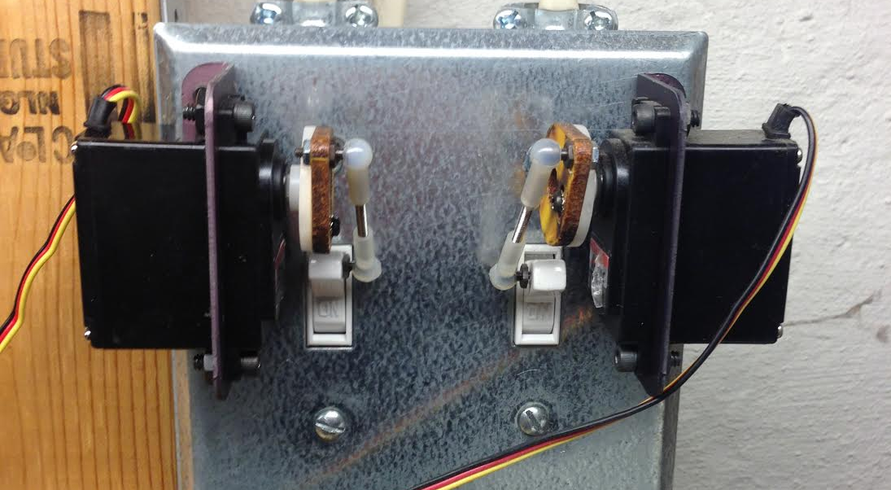
Before X10 ~ $7 Switch

Slide 15
Used SSC (Still Used)
Lights On
http://192.168.1.60:8001/?pin=2&pos=200
http://192.168.1.60:8001/?pin=3&pos=70
Lights Off
http://192.168.1.60:8001/?pin=2&pos=127
http://192.168.1.60:8001/?pin=3&pos=127

Slide 16
X10 – External Lights

Slide 17
What’s X10?
Developed in 1975 by Pico Electronics (Scotland)
Digital Carrier transmitted onto a 120hz carrier existing power lines.
Limitations – GCFI Outlets, Older Technology, Reliability, # of Devices
Pros – Cheap, Nothing else around in 2008, Microcontrollers have built-in support

Slide 18

X10 – TW523 Interface~$60-$80

Slide 19
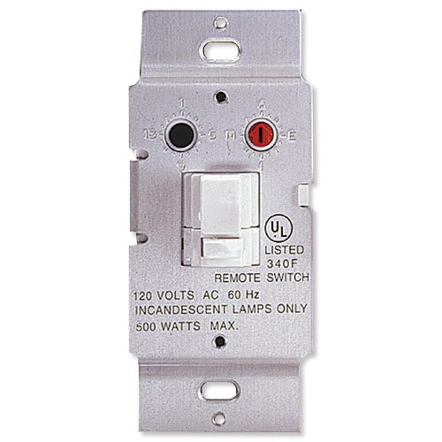
X10 – WS467 $16.99

Slide 20
X10 – Protocol (via BS2)
XOUT mPin, zPin, [houseCode\unitCode]
XOUT mPin, xPin, [houseCode\onORoff]
houseCode = 1-16
unitCode = 1-16
onORoff = 0, 1

Slide 21
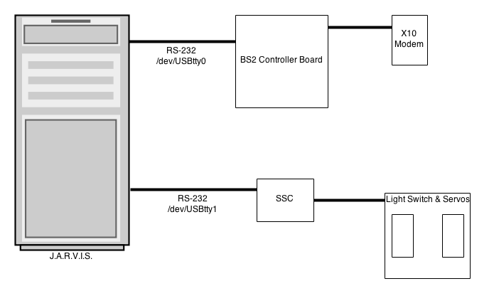
Initial Layout

Slide 22
Node Set-Up
npm install serial-port (Serial Ports)
npm install serial-servo (Serial Servo Controllers)

Slide 23
X10.js – SerialPort
var http = require('http');
var url = require('url');
var port = 8000;
var usbport = "/dev/ttyUSB0";
var SerialPort = require("serialport").SerialPort;
var sp = new SerialPort(usbport, {
baudrate: 9600
});
Serial Port Setup

Slide 24
X10.js – Server Code
var server = http.createServer(function (request, response) {
var url_parts = url.parse(request.url, true);
var house = url_parts.query.house;
var device = url_parts.query.device;
var onoff = url_parts.query.onoff;
write(house,device,onoff);
});
Http Parms to Serial Port

Slide 25
X10.js – Serial Writing
function write(house, device, onoff) {
if (house >= 0 && device >= 0 && onoff >= 0) {
var b = [100, house, device, onoff];
sp.write(b);
}
}
Byte[] sent to serial port

Slide 26
Sunrise & Sunset
http://api.wunderground.com/api/USER_KEY/astronomy/q/43212.json
Gets sun-rise
Gets sun-set
CRON runs each minute and checks for time match

Slide 27
Weather Underground – REST API
http://api.wunderground.com/api/USER_KEY/conditions/q/43212.json
Schedule Via CRON (hourly)
Populate to database via wrapper.

Slide 28
Putting It All Together
Old Robot Parts w/Serial & X10
X10 Switches
Weather Underground w/Sunrise & Sunset Data
CRON Scheduler
Results: Robot that can turn on/off lights for me.
Missing: Text-To-Speech (later)

Slide 29
More Devices
Since X10 is 40 years old

Slide 30
Kinds Of Devices (non-X10)
Proprietary (Lots of these) – On their own
Wifi – Many devices, limited APIs & Smart Phones
BLE – Blue Tooth Low Energy (Smart Phone Only)
Z-Wave – Need Interface (Wireless)
Insteon – Need Interface module Wireless + X10

Slide 31
Kinds Of Devices (non-X10)
Proprietary (Lots of these) – On their own
Wifi – Many devices, limited APIs & Smart Phones
BLE – Blue Tooth Low Energy (Smart Phone Only)
Z-Wave – Need Interface (Wireless)
Insteon – Need Interface module Wireless + X10

Slide 32
Kinds Of Devices (non-X10)
Proprietary (Lots of these) – On their own
Wifi – Many devices, limited APIs & Smart Phones
BLE – Blue Tooth Low Energy (Smart Phone Only)
Z-Wave – Need Interface (Wireless)
Insteon – Need Interface module Wireless + X10

Slide 33
Kinds Of Devices (non-X10)
Proprietary (Lots of these) – On their own
Wifi – Many devices, limited APIs & Smart Phones
BLE – Blue Tooth Low Energy (Smart Phone Only)
Z-Wave – Need Interface (Wireless)
Insteon – Need Interface module Wireless + X10

Slide 34
Device Types
Controllers
Locks
Thermostats
Sensors
Lights
Switches
Smart Meters

Slide 35
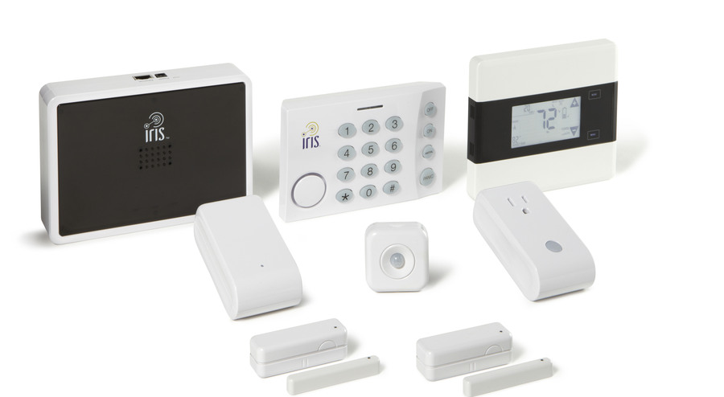
Proprietary - IRIS by Lowes
Some devices Z-Wave Compatible!

Slide 36
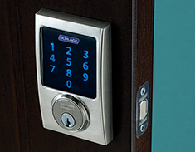
Schlage Z-wave Lock

Slide 37
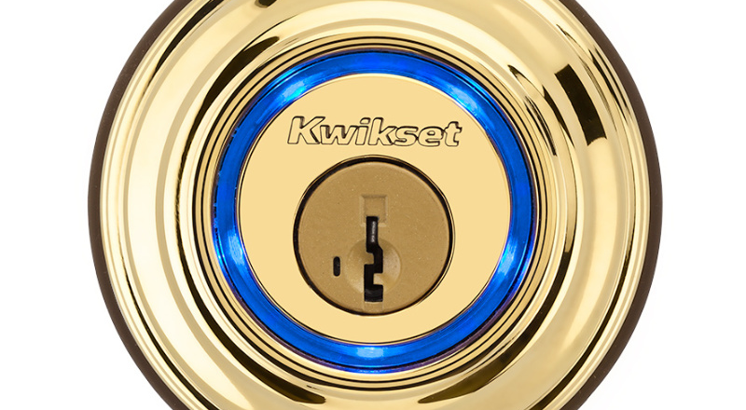
KEVO – Bluetooth LE (Not Z-Wave)

Slide 38

Kwickset – Z-Wave

Slide 39
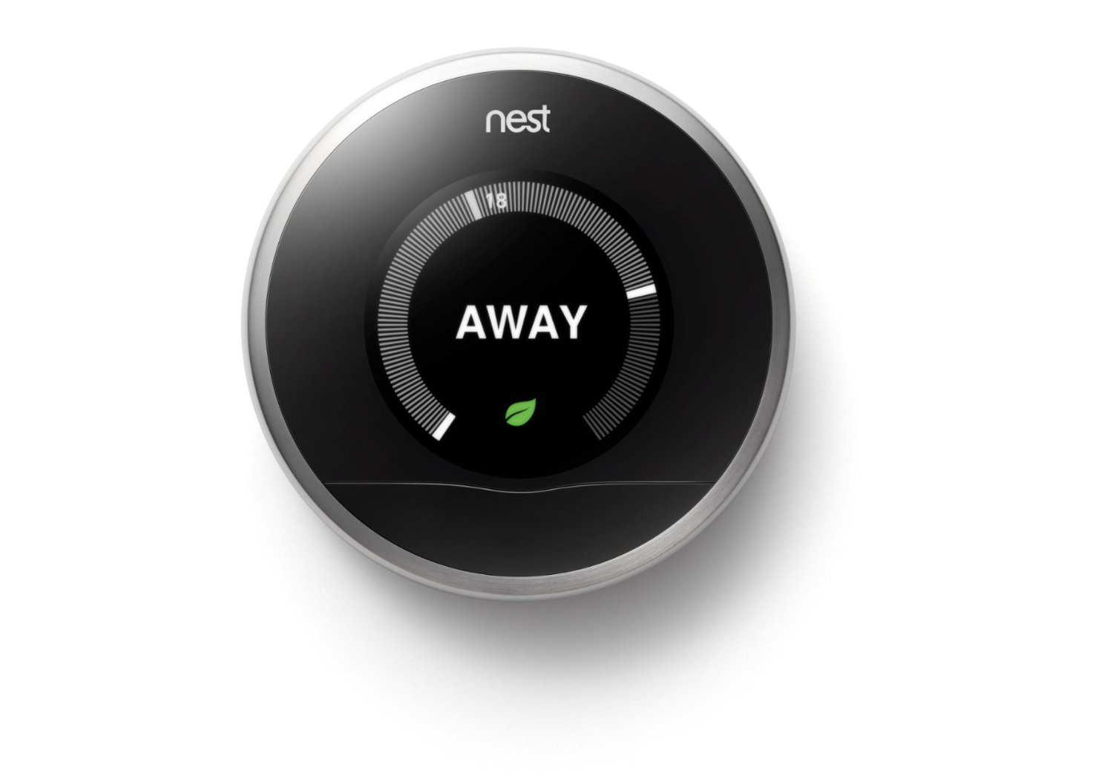
nest Thermostat ($250)
REST API available from nest and full SDK.

Slide 40
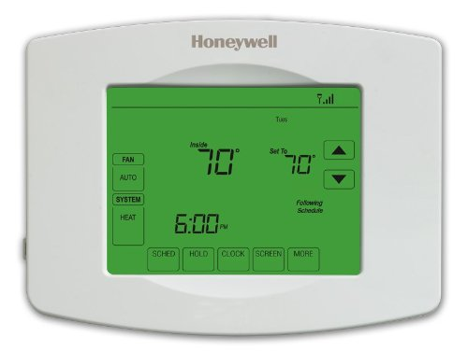
Z-Wave + WiFi ~$75 to $200

Slide 41

Aeon Labs – Z-Wave Switch

Slide 42

Phillips Hue (Zigbee & Ethernet)
http://www.developers.meethue.com/tools-and-sdks

Slide 43

WeMo – WiFi Switch
Many NPM modules available to use.

Slide 44

Z-Wave Flood Sensor

Slide 45
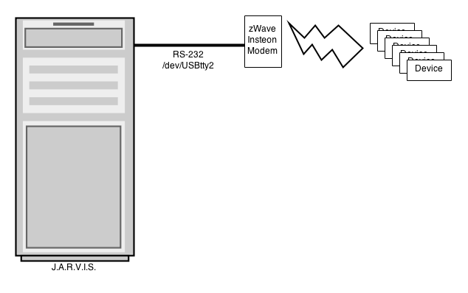
Z-wave Interfacing

Slide 46
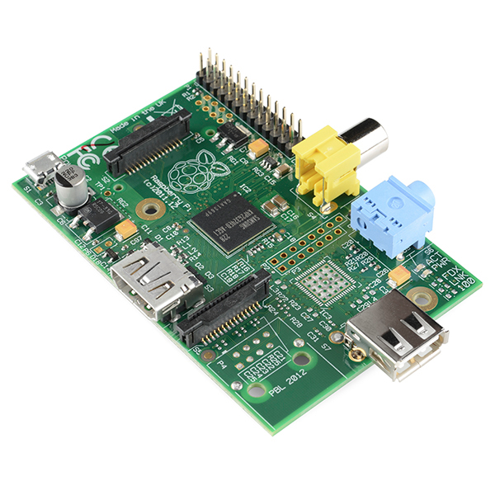
Raspberry Pi ~ $30

Slide 47
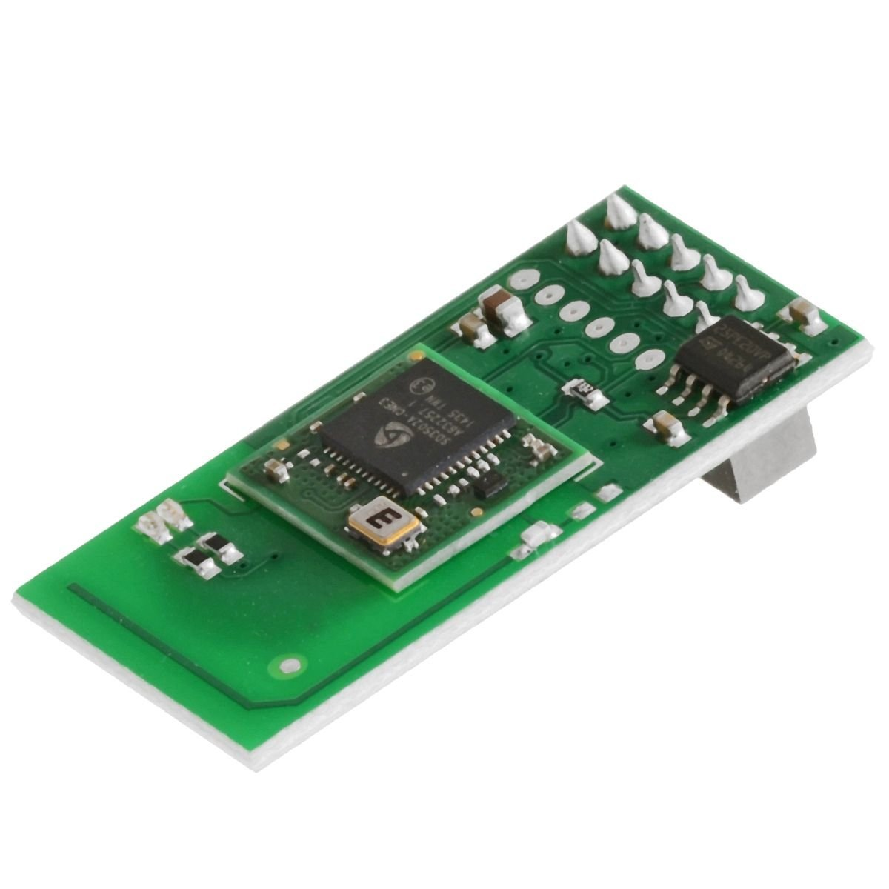
Z-Wave GPIO Daughter Card - $60
http://razberry.z-wave.me/

Slide 48
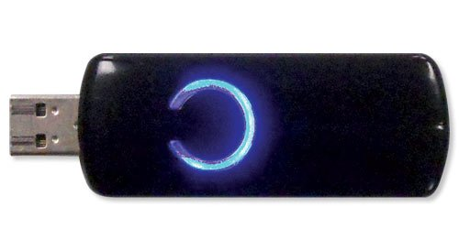
Z-Wave USB ~$40
Google ‘openzwave’ for npm modules.

Slide 49
How close are we to J.A.R.V.I.S.?

Slide 50
J.A.R.V.I.S.
Home Sensors
Home Control (Lights/Blinds/Etc.)
Speech Recognition / Text-To-Speech
Computer Vision
TV / Stereo Control
Event Based System & Robot Control
3D Metal Printers

Slide 51
Speech Recognition
w/Sphinx4
Open Source Java Speech Recognition

Slide 52

Wrote this book in 2005.

Slide 53
Text To Speech
3rd Party Voice (Cepstral TTS)
Festival TTS (Free)
Linux command I’m using:
/usr/bin/padsp swift “words to speak”

Slide 54
Remote Text To Speech
swift "$1" -o tmp.wav // create wav
lame tmp.wav tmp.mp3 // convert to mp3
scp tmp.mp3 pi@10.10.10.32:tmp.mp3 // send
ssh pi@10.10.10.32 'mpg123 tmp.mp3' // play

Slide 55
Remote Text To Speech
swift "$1" -o tmp.wav // create wav
lame tmp.wav tmp.mp3 // convert to mp3
scp tmp.mp3 pi@10.10.10.32:tmp.mp3 // send
ssh pi@10.10.10.32 'mpg123 tmp.mp3' // play

Slide 56
Remote Text To Speech
swift "$1" -o tmp.wav // create wav
lame tmp.wav tmp.mp3 // convert to mp3
scp tmp.mp3 pi@10.10.10.32:tmp.mp3 // send
ssh pi@10.10.10.32 'mpg123 tmp.mp3' // play

Slide 57
Remote Text To Speech
swift "$1" -o tmp.wav // create wav
lame tmp.wav tmp.mp3 // convert to mp3
scp tmp.mp3 pi@10.10.10.32:tmp.mp3 // send
ssh pi@10.10.10.32 'mpg123 tmp.mp3' // play

Slide 58
How do I talk to J.A.R.V.I.S.?
Microphone
Wireless Headset
Bluetooth
Skype via API?
Skype as Services??

Slide 59
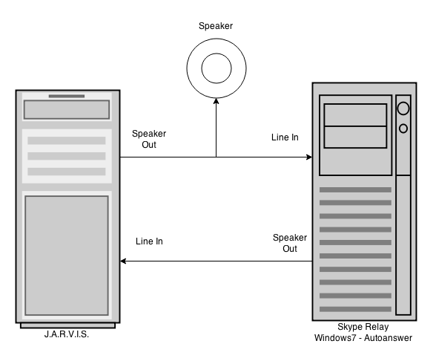
Skype As Service (low-tech)

Slide 60
Putting It all Together
Speech Recognition – Publishing Events
Text To Speech either via Speaker, Skype (Phone) or Remote Speaker
Tell J.A.R.V.I.S. to turn on lights and turn off lights

Slide 61
J.A.R.V.I.S Voice Demo

Slide 62
What Next?

Slide 63
Computer Vision
9 Network Cameras in Total
To Report Motion Detection Events
Each capable of doing face recognition (still debugging)
J.A.R.V.I.S. – Using Java based motion detection in multiple threads for each camera defined via UI
Table of Camera Stored in J.A.R.V.I.S Database

Slide 64

Foscam Pan/Tilt
Resolution 640x480 and 1280x720

Slide 65
Camera Parameters
Name
Snapshot_url for taking JPG image
Sample Frequency in milliseconds
Sensitivity
Top, Left, Height, Width
Notify URL / Event To Publish

Slide 66
Vision Summary
9 Cams Mapped To Location
J.A.R.V.I.S. monitors “motion” events and “face” events
Checks For Motion every 500ms to 2000ms
Face checks only if motion

Slide 67
TV / Stereo Control
Device Might Have an API
LIRC w/Raspberry PI

Slide 68
DirecTV - Power On
http://192.168.1.99:8080/remote/processKey?key=poweron&hold=keyPress

Slide 69
DirecTV – Power Off
http://192.168.1.99:8080/remote/processKey?key=poweroff&hold=keyPress

Slide 70
DirecTV – Change Channel
http://192.168.1.99:8080/tv/tune?major=10

Slide 71
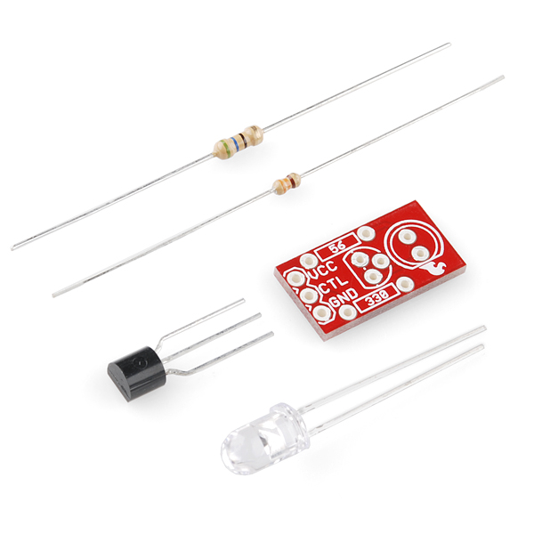
Sparkfun – Max Power LED $2.95

Slide 72
LIRC
Linux Infrared Remote Control - http://www.lirc.org/
apt-get install lirc
update /etc/modules
update /etc/lirc/hardware.conf
update /etc/lirc/lircd.conf

Slide 73
Invoking From Service
Use php exec(garage-power.sh)
#!/bin/bash ssh pi@10.10.10.32 'irsend SEND_ONCE yam POWER'
** Subscribe to STEREO_ON event, calls shell

Slide 74
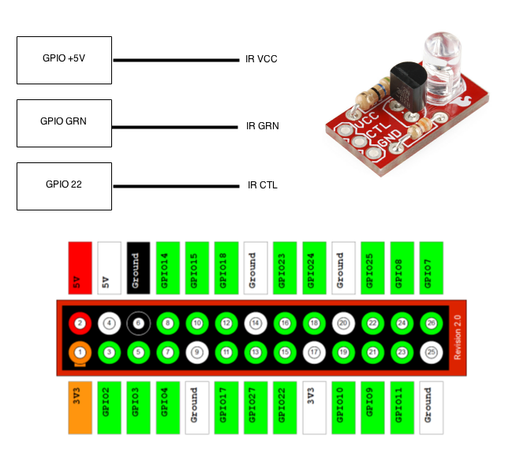
LIRC Diagram
Raspberry PI GPIO

Slide 75
lircd.conf
begin remote
name yam
bits 32
flags SPACE_ENC
eps 20
aeps 200
header 8800 4400
one 550 1650
zero 550 550
ptrail 550
repeat 8800 2200
gap 38500
toggle_bit 0
frequency 38000
begin codes
POWER 0x000000005EA1F807

Slide 76
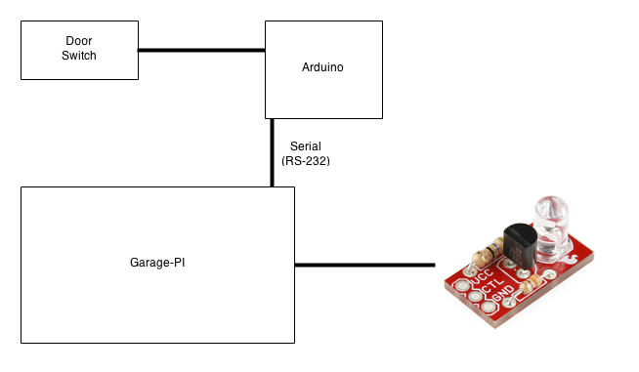
Garage Wiring Diagram

Slide 77
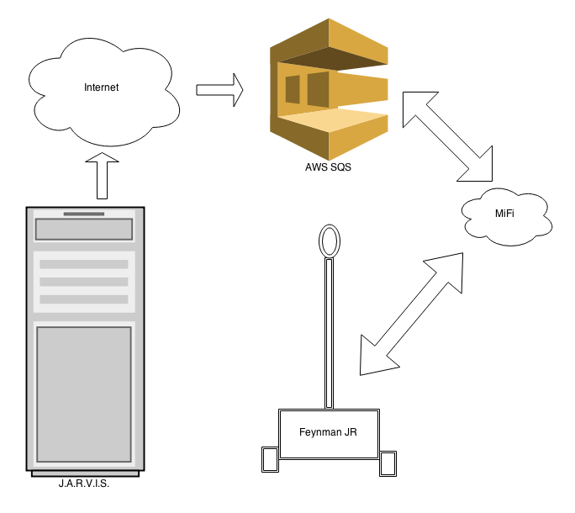
Non-Local Events - SQS

Slide 78
J.A.R.V.I.S & Feynman JR. DEMO

Slide 79
Thank You
@scottpreston
Http://github.com/scottpreston

